Slide 1
Genshin TFT
By Anthony Bisgood, Daniel Shevelev,
Jonathon Eichenberg, and Zach Empkey

Slide 2
Why we did Genshin TFT
Genshin and TFT are both great games to play, so why not combine them!

Slide 3

Getting started
Each player starts off with 30 hp and gold.
The first stage is a shop phase, where you can buy champions and place them from your board to your bench.
After 30 seconds the battle round will start!
During the battle round champions will fight against each other at random.
To win the battle round, all the other player champions must die (reach 0 hp). Once this happens, each player will be rewarded gold based on the result and damage will be given to the loser.

Slide 4
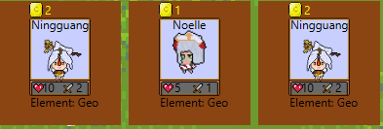
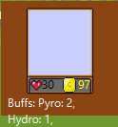
Team Synergies
There are 6 different types of champions, Pyro, Cryo, Anemo, Geo, Electro, and Hydro.
When you combine 3 different units with the same type, you will be given a class bonus that gives extra hp and attack!
In addition, champion stats will match their elemental resonance, so Geo champs will have high hp but low attack.
Team Synergies will be shown right next to your player icon, and if you have 3, that means you get a bonus!

Slide 5

Shop Phase
In the shop phase you will be given the chance to buy from 3 units with your gold.
Champions will range from 1 to 3 cost, with the more expensive champions being better but harder to find.
Leveling up will increase the chance to find a 3 star unit, but also decrease the chance to find a lower cost one.
To reroll the shop simply click the reroll button at the cost of 1 gold.
Each shop phase lasts 30 seconds

Slide 6

Leveling and items
As mentioned before leveling up your player will increase the chance of finding better champions.
Leveling will also increase your chances of finding better items!
Items drop at random, with better items being more rare. Leveling up makes it easier to find items and make your team stronger!
Leveling costs 5 times your current level, so if you’re level 3, it’ll cost 15 gold to upgrade your level, with a max of level 5.
When you use your items, make sure you place it on the right champion though, champions can only use the item that fits them!

Slide 7
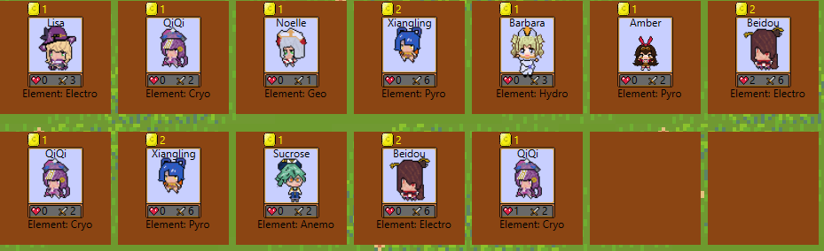
Attack phase
During the attack phase a player is chosen at random to attack first, when attacking champions will choose at random who to attack, and both will take damage when the attack happens.
The damage given to the other player after the attack phase directly correlates to the round, so if its round 5, whoever loses will take 5 damage!

Slide 8
Good luck and have fun!

